Slide 1
Sentiment Analysis
Final Project Presentation
Yusif Abbasov
Fuad Abbaszada
Ruzgar Turhan

Slide 2

Introduction
What is the scope of project?

Slide 3

Motivation
What is the purpose of the project - classification of the sentences according to their sentimental meanings
Where can it be used?
Banks
Malls
Restaurant

Slide 4
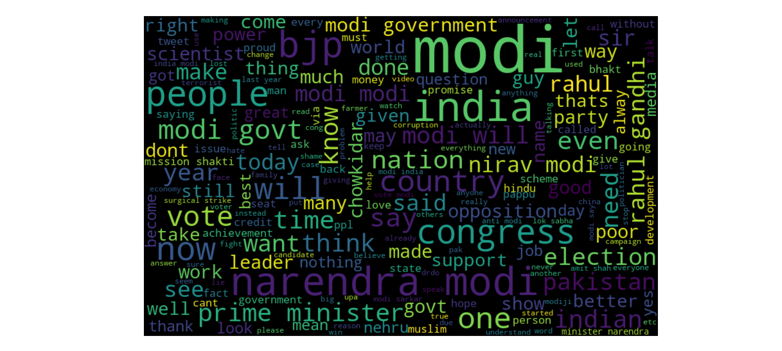
Most used positive and negative words in dataset

Slide 5
Split
Tokenization: Split the text into individual words or tokens.
Lowercasing
Lowercasing: Convert all words to lowercase to ensure uniformity.
Removing
Removing Stopwords: Eliminate common words (e.g., "and", "the") that do not carry significant meaning.
Stemming
Stemming or Lemmatization: Reduce words to their root form to handle variations (e.g., "running" to "run").
Handling
Handling Special Characters: Remove or replace URLs, special characters, and punctuation marks.
Convert
Vectorization: Convert text data into numerical form (e.g., Bag-of-Words, TF-IDF, Word Embeddings).

Slide 6
Model Selection:
Choose a suitable model for sentiment analysis such as:
Logistic Regression
(Denied)
Naive Bayes
Model Training:
Train the selected model using the training data. The model learns to associate features (words or word embeddings) with sentiment labels during this phase.
Model Evaluation:
Evaluate the trained model's performance on the validation set using metrics like accuracy, precision, recall, and F1-score.
Model Testing:
Evaluate the final model on the testing set to assess its generalization performance.
Deployment:
Deploy the model in a real-world environment where it can be used to analyze sentiment in new data.

Slide 7
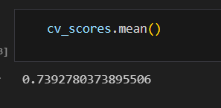
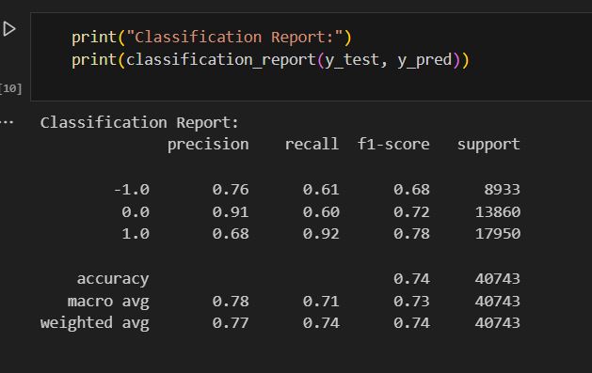
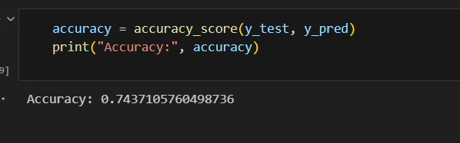
Cross-validation Score
Classification Report
Accurancy

Slide 8

Future scope:
Preprocessing:
Handling Emoticons and Abbreviations
Handling URLs
Handling Rare Words
Testing:
Hyperparameter Tuning
Testing

Slide 9
Contribution
Yusif | Fuad | Ruzgar
In the deployment phase, my focus was on creating an efficient and user-friendly interface for our sentiment analysis model. I developed a web application using Flask, a lightweight Python web framework, to allow users to interact with the model seamlessly. The application provides a simple text input interface where users can enter their text data, and the model returns the sentiment analysis results in real-time. I also integrated error handling and logging functionalities to ensure smooth operation and easy troubleshooting. By deploying the model as a web application, we make it accessible to a wide range of users, empowering them to analyze sentiment quickly and conveniently. | During deployment, my role was to optimize the model for scalability and performance. I leveraged containerization technology such as Docker to package our sentiment analysis model and its dependencies into lightweight, portable containers. This allows the model to be easily deployed and scaled across different environments, from local development to cloud-based production servers. Additionally, I implemented load balancing and auto-scaling mechanisms to ensure that our application can handle varying levels of traffic efficiently. By optimizing for scalability, we ensure that our sentiment analysis service remains responsive and reliable, even under high demand. | In the deployment phase, I focused on ensuring the security and privacy of our sentiment analysis model and the data it processes. I implemented encryption mechanisms to protect sensitive information transmitted between the client and server, ensuring that user data remains confidential. Additionally, I integrated authentication and authorization features to control access to the sentiment analysis service and prevent unauthorized use. By adhering to industry best practices for security, we build trust with our users and safeguard their data throughout the deployment process.

Slide 10
Conclusion
Thank you for the attention!

Slide 11

References:
https://medium.com/@zubairashfaque/sentiment-analysis-with-naive-bayes-algorithm-a31021764fb4
https://web.stanford.edu/~jurafsky/slp3/slides/7_Sent.pdf
https://medium.com/analytics-vidhya/na%C3%AFve-bayes-algorithm-5bf31e9032a2
https://github.com/vyashemang/flask-salary-predictor/tree/master
https://monkeylearn.com/sentiment-analysis/
https://www.sciencedirect.com/science/article/pii/S2090447914000550
https://ieeexplore.ieee.org/abstract/document/7912034
https://pubs.aip.org/aip/acp/article/1867/1/020060/972740/Aspect-based-sentiment-analysis-to-review-products
https://www.tensorflow.org/tutorials/keras/save_and_load
Dataset:
Dataset - kaggle.com

